Slide 1
Building Apps for the Office Store
Jim Epes, Office Store Product Marketing Manager
Scot Hillier, Office 365 MVP

Slide 2
Getting Your App Submitted & Approved: Best Practices
Module 3

Slide 3

Agenda
Overview
Build Your App
Create an Account in Seller Dashboard
Add an App
SP Provider Hosted Apps
Managing App Performance
Review of Common Blockers

Slide 4















Vision
EXTEND OFFICE EVERYWHERE
CONNECT TO OFFICE 365 SERVICES
BUILD USING AN OPEN PLATFORM
Delve
z
Users and groups
Files
Mail
Calendar
My Apps
Video Portal
Contacts
Office Graph
Presentations
Documents
Spreadsheets
Lync
OneNote
Yammer

Slide 5
Overview

Slide 6
The Store Submission Process: Summary
Build your app for the Office Store (a few unique requirements)
Create a Seller Dashboard account (using MSA) at https://sellerdashboard.microsoft.com/Registration
Decide on pricing, then add payout and tax information
Add your app(s) in one or more supported languages and countries
Can Add and Save apps even while account is under review
Submit free apps for Store approval once account is approved, and paid apps once Tax and Payout info is validated
Submit your apps for Store approval
Seller Dashboard will communicate approval status, needed changes and detailed reports on submission errors
Once approved, extensions show up in Store in 1-3 days
Track your Metrics and manage your money
Seller Dashboard will track the details

Slide 7
Step 1: Build your App

Slide 8
Getting Started
http://dev.office.com/getting-started Section 2, “Set up your environment”
Can create App Package/Manifest in Visual Studio, using Office Developer Tool wizard, or use other IDEs
Can now also build Office 365 extensions announced at TechEd, but not yet in the Store nor ingested via Seller Dashboard.

Slide 9
Getting the App Manifest “Store-ready”
Be mindful of consistent app naming during submission
Name in Manifest = what app is called within Office or SharePoint after user install
Seller Dashboard name = what app is called in the Store.
Failure to match the two names exactly will create user confusion!
Use the Manifest Display Name element (apps for Office), or Title Element (apps for SharePoint).
You must submit icons for Store Apps twice, in two different places
Mail, Task Pane & Content apps:
A link to icon in the App Manifest determines how app looks within Office products (e.g., “My Apps” in Ribbon)
An uploaded icon in Seller Dashboard is used to represent how Apps appear in the Store.
In-product Mail icons are larger and must be secured by HTTPS (see Notes)
SharePoint apps have unique icons (96x96 pixels), loaded within the app package, and identical to the SD icon)
Provider-hosted SharePoint Store apps require use of Seller Dash for Client IDs & Secrets
Client IDs and Secrets enable remote app components to gain access to SharePoint data without user credentials
When building for the Store, you CANNOT use SharePoint to create IDs and Secrets (OK for side-loaded apps)
These SD-created elements are then entered into the app’s web.config and Manifest files file in your Visual Studio project
Notes:
In-product Task Pane and Content icons must use one of these formats: .bmp, .gif, .jpg, .png, or .tiff
Mail app icons: 64x64 pixels & secured by HTTPS; Task Pane & Content icons are 32x32 and don’t need HTTPS.
All icon links created via the IconURL element in the app manifest

Slide 10
Step 2: Create an Account in Seller Dashboard

Slide 11
Seller Dashboard: Account checklist
Does SD support the country/region where you live?
Most are supported; check here
What kind of account do you want? (Important: You can’t change this later!)
Company Account if registering on behalf of a corporation, LLC, partnership or other company type
Individual if registering as an independent developer
Prepare a marketing profile
Describes your expertise and how your apps will benefit customers.
Info is audited for grammar, spelling, accuracy, uniqueness, quality, completeness and other criteria, as we’ll see.
Make sure you meet all the guidelines!
Registration often blocked due to inaccurate address/phone information, a non-compliant Microsoft Account, etc.

Slide 12
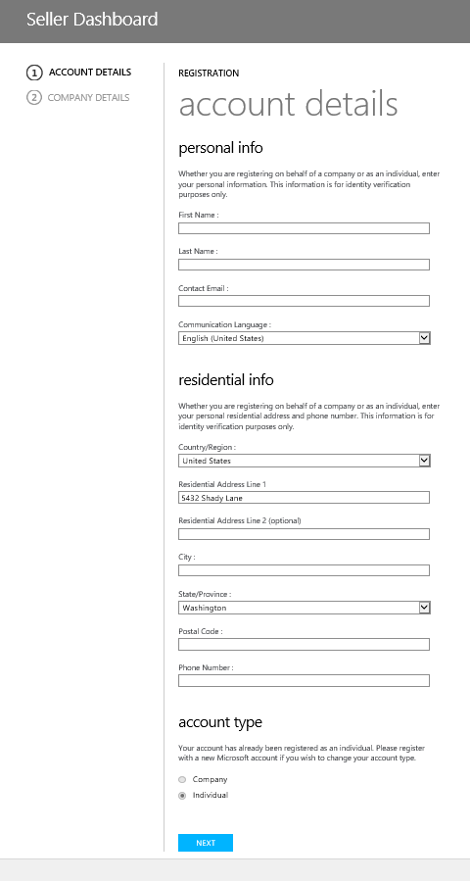
Account creation walkthrough
Complete ALL SECTIONS here regardless of Account Type. Info is used for verification only.
Company Accounts should enter Personal Info for the designated Seller Dashboard admin (their business contact info is OK).
IMPORTANT: Under “residential info,” do not enter a company address or phone number for the Dashboard admin. Enter their home address and personal phone number or registration will fail.
IMPORTANT: if you or your company has already registered a Microsoft Account with one of our other Stores, you must reuse that account to register here, with the same Name & Address. Otherwise the account will not be approved.
Select account type (Individual or Company).
IMPORTANT: You cannot change this later!

Slide 13
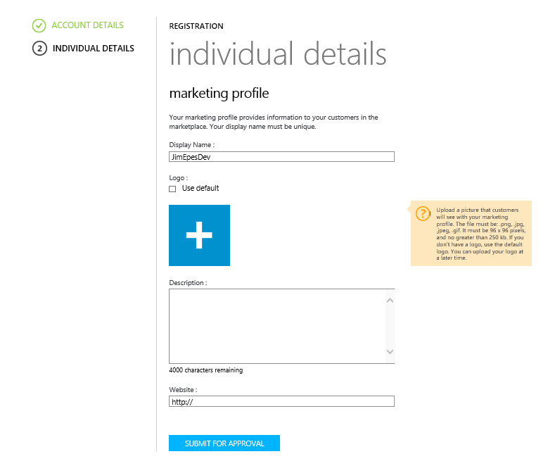
Marketing Profile: Individual
Display Name is how you will appear in the Store. It will be rejected if it’s already in use or too generic.
This will be your developer icon in the Store. Submit during account creation, or later, in the size (96x96 pixels, <250 KB) and formats called out in the tan box.
TIP: scan the logo for viruses before uploading.
Submit a concise, plain-text description of your company’s skills, and the value provided by your apps. Shorter is better. One bulleted list (using “-” or [#LI] and [/#LI] for bulleting) is allowed. Check for spelling and grammar errors.
Provide a website where customers can learn more about you. You must own the site’s contents and it must be functioning. Make sure the URL includes http:// or https://

Slide 14
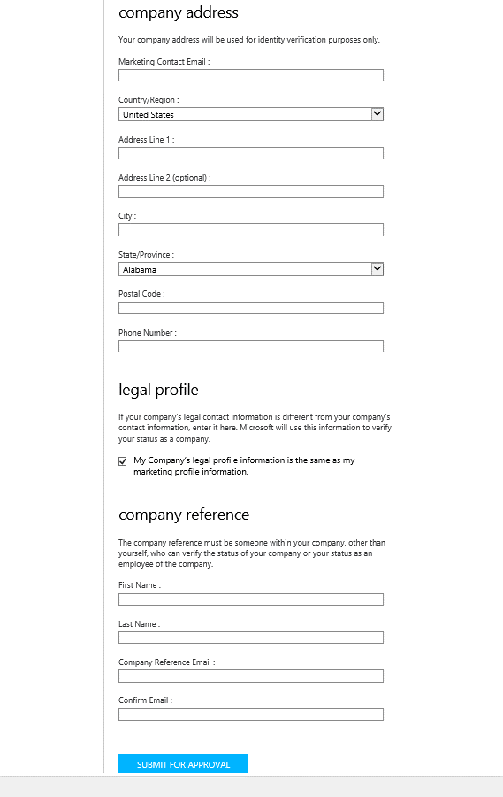
Marketing Profile: Company
The top half of the Company Profile (Display Name, Logo, Description, Web Site) works the same as for Individual Profiles. See prior slide.
NOTE: “Company Name” must be the full registered company name, unique from others in SD, and the same you used to register to sell in any other Microsoft Store
Company address used for account verification only.
Submit a unique legal contact only if different from company contact. Otherwise keep the box checked. (Used only for verification).
Submit a company contact other than yourself who can verify company status and your status as an employee. Be sure to notify this person that they’ll need to verify as requested for the account to be approved.
Click “Submit for Approval”

Slide 15
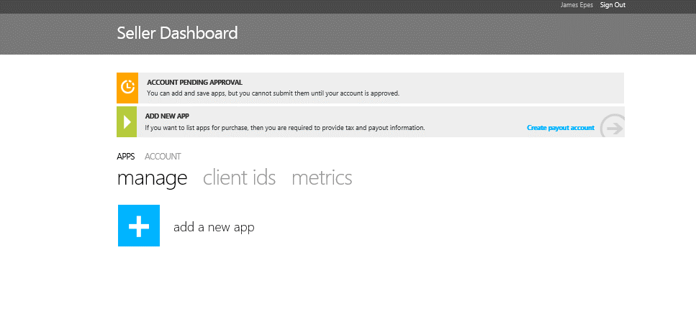
Account is now pending approval
You can now add apps to your account (but not yet publish to Store)

Slide 16
Account Approval: How it Works (Pt. 1)
Approval can take 1-14 days.
If 14 days pass with no word, go to Support and select options from droplist
Approval Phase I: Identity validation
Is the developer who they say they are?
This protects developers from impersonators and assures customers that apps are coming from a trustworthy source.
Is the submitter truly affiliated with the named company & authorized to submit apps?
Expect an email or phone call to confirm this – timely responses speed validation
Did the submitter provide a personal address and phone number (even if submitting on behalf of a company)?
Note: Microsoft uses 3rd-party agencies, such as Dun & Bradstreet, to help confirm identity and tax information.

Slide 17
Account Approval (Pt. 2): Information Audit
Marketing Profile
Describes company expertise; software & service offerings; benefits of listed app
Free of spelling and grammatical errors, inappropriate language, etc..
Profile written in Plain Text with no formatting other than a max of one bulleted list in the approved formats
Display Name / Company Name: Unique and non-generic
Website: functional and owned by submitter
Named Company Reference: Verifies status when contacted
Developer MSA: Same account used to sell in other Microsoft Stores (if any)
Logo
Size is 96x96 pixels (250 KB max), in .png, .jpg, .jpeg, or .gif format.
File contains no inadmissible or offensive images

Slide 18
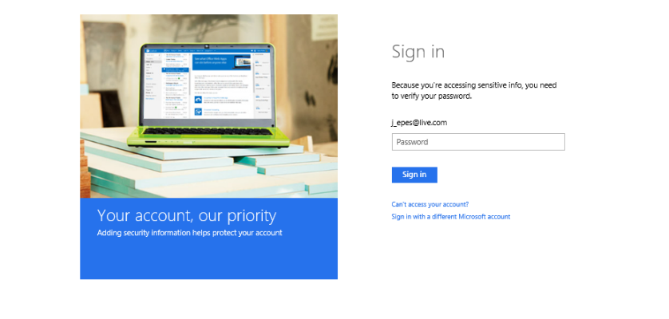
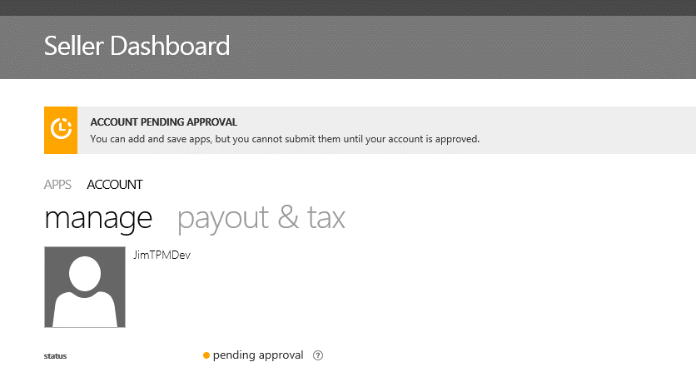
Add Payout and Tax Information
Needed only if you plan to offer Paid apps. Can be added later if desired.
Because financial data is sensitive, you’ll need to sign in again
From SD home page, select “Account” tab, then “Payout & Tax”

Slide 19
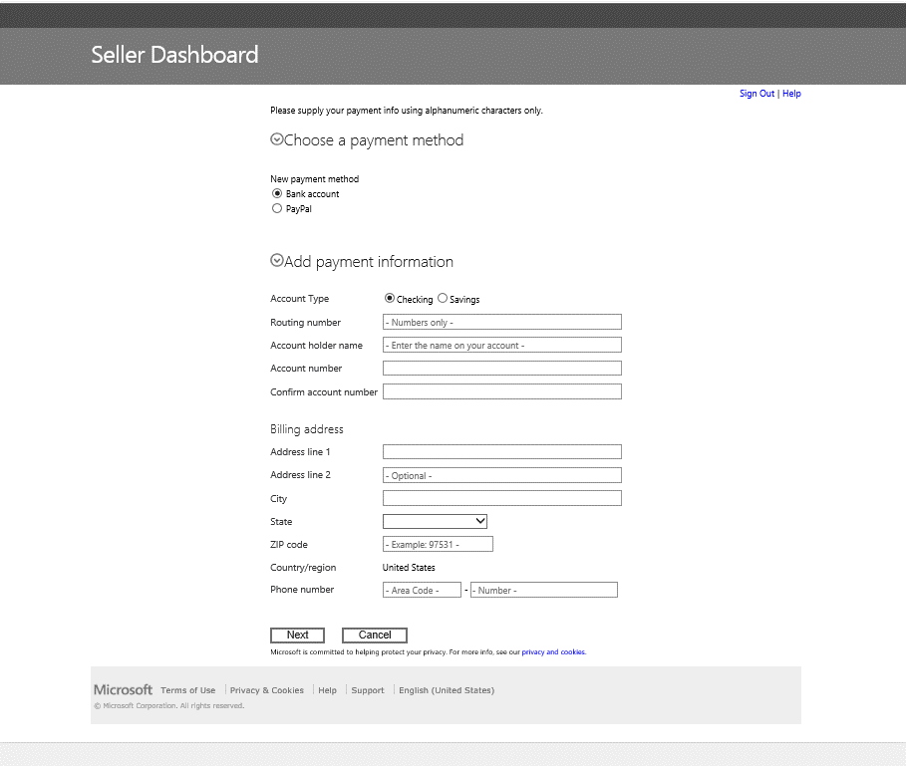
Payout info
Choose Payment Method (Bank Account or PayPal)
Enter relevant account info and developer’s billing address
Click “Next”

Slide 20
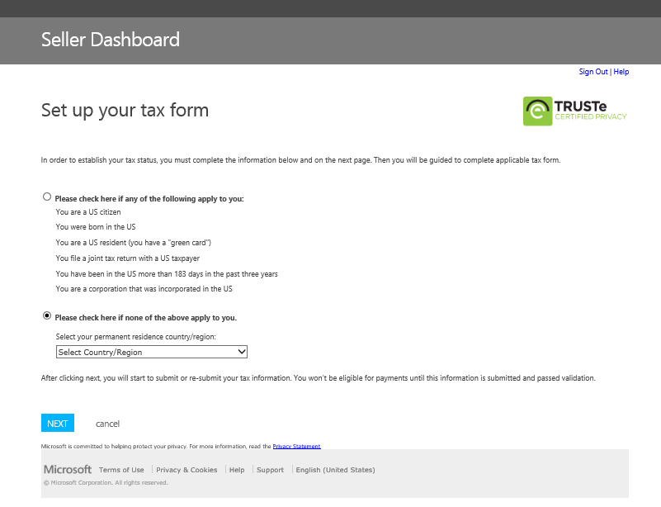
Tax Info
Indicate citizenship / residency status by selecting one of two radio buttons
If your permanent residency status is outside the U.S., select your country or region of residency, then click “NEXT”

Slide 21
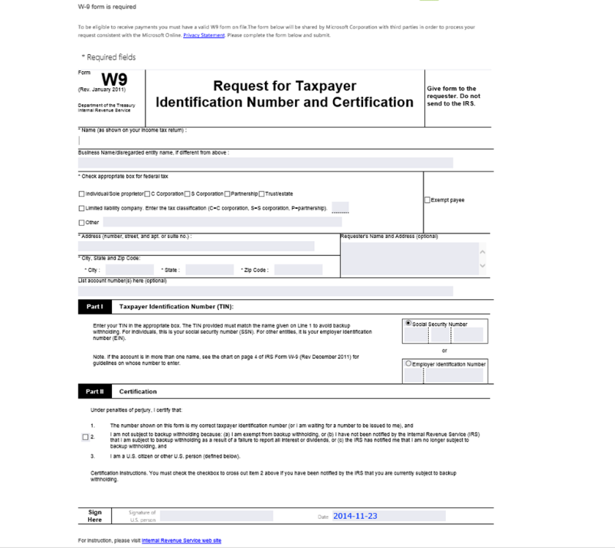
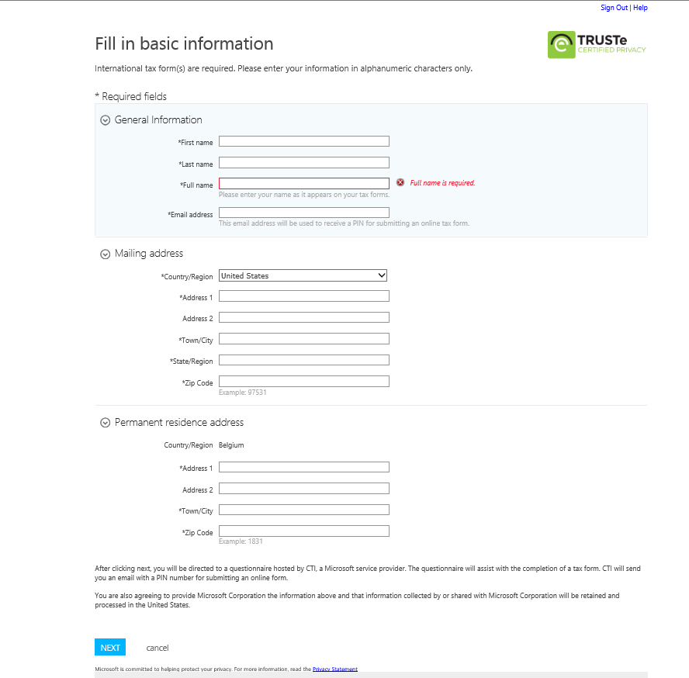
Filing Tax Info
U.S. residents fill out Form W9 (below left). Follow formatting instructions EXACTLY.
All others complete the SD form at right and are sent an email, PIN and links to the appropriate online forms for their country (below right)

Slide 22
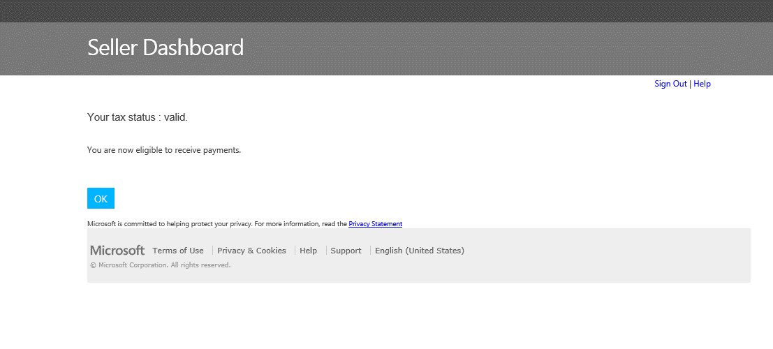
Success!

Slide 23
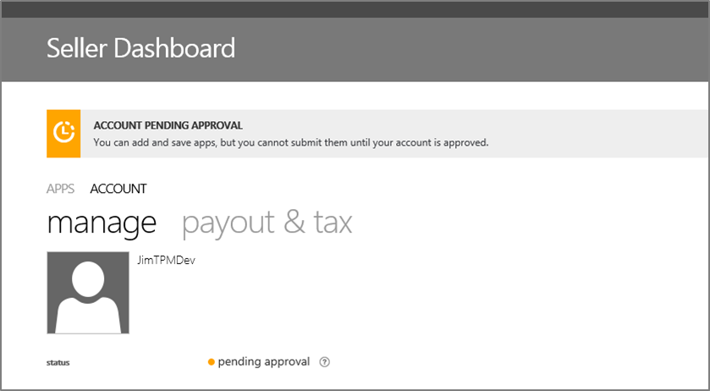
Managing your Account
Each time you edit your account (via the SD “Manage” tab), it undergoes approval again
Account status will flip to “Pending Approval” in the “Manage” tab (see below)
Approval is likely to occur more quickly for small changes
While changes are reviewed, your published apps remain in the Store
But app listings won’t reflect changes to your Marketing Profile until they’re approved in Seller Dashboard
If something needs correcting, you’ll instead see a “Changes Requested” banner and a “View Report” link to details on the problem

Slide 24
Step 3: Add an App

Slide 25
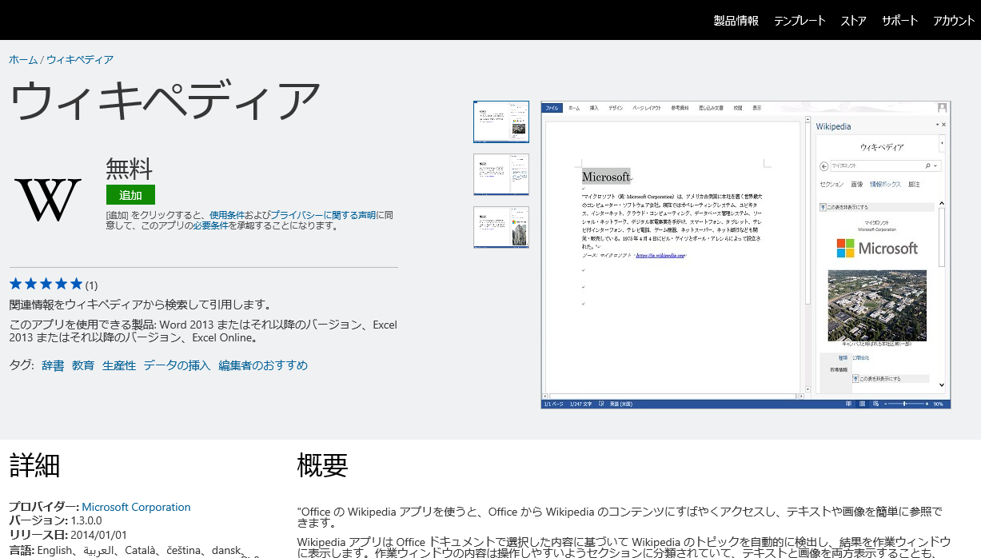
Adding an App: Key Decisions
Review the Store Validation Policies and App Validation Checklist to avoid common mistakes
Decide which languages & markets to offer your app in
Minimum: Localized metadata in Store listing
Better: Localized App User Interface
China Apps: Require separate app package, app listing, Client ID / Secret, & block access (via SD) in all other countries
Note: Adding a language will create support incidents in that language
Set Pricing
Options: Free, Paid per-user (Perpetual or Monthly Subscription), and whether either Paid version comes with a Trial version
SharePoint and Mail apps offer additional pricing options
Trial length and max # users is configurable in SD
App behavior at Trial’s end is up to developer (disable or reduce functions, etc.)

Slide 26
Adding an App: Prepare all the Ingredients
Wording for all the text entries
App Title, Name, Short and Long descriptions, all localized as needed
Correct metadata
App Version number, Release date, 1-3 browse Categories to which app should be assigned in the Store
Compliant app logo, and 1-5 screenshots
Testing Notes so Office testers can validate the app (not shared with public)
Include valid test-logon credentials, links and instructions
Links to your Support documentation and Privacy Policy
Optional: links to an app-demo video and a custom End-User License Agreement

Slide 27
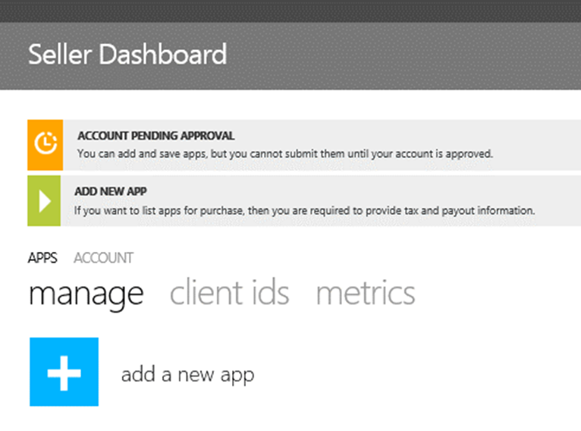
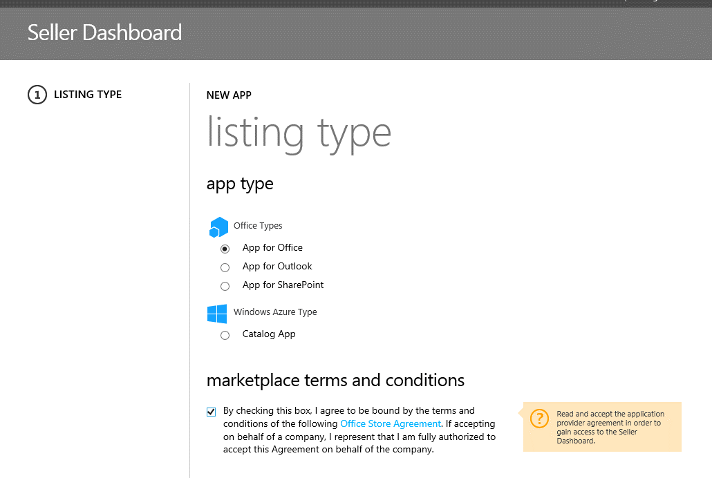
Add an App: Walkthrough
2. Select the App Type (Office, Outlook, or SharePoint)
1. Click “add a new app” in the SD
3. Accept Office Store Terms and click “Next.” You can always review the Agreements you have accepted on the “Account – Manage” tab of Seller Dashboard

Slide 28
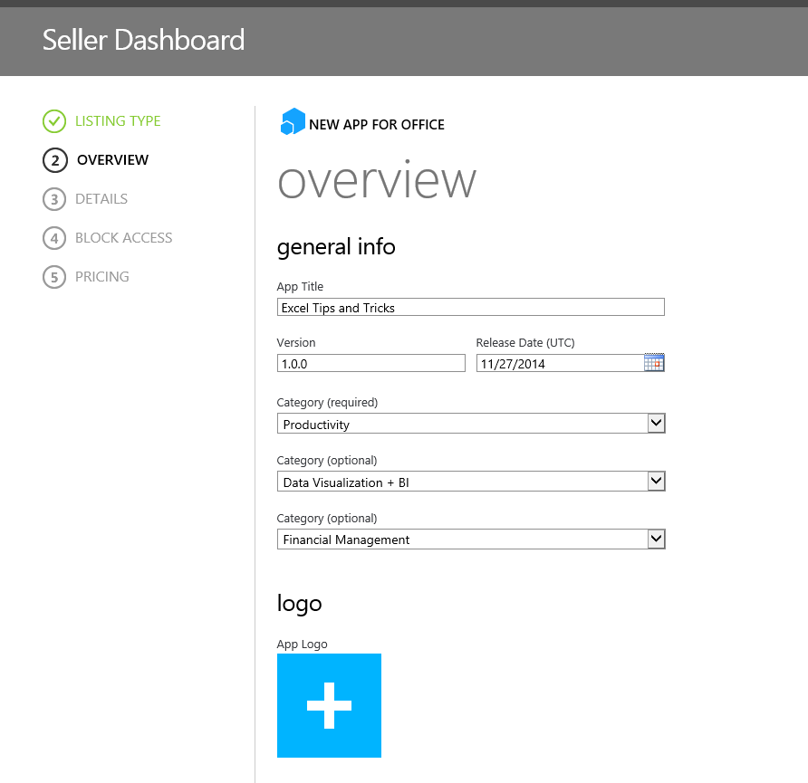
App Overview
App Title appears in the Store & Overview page of SD. Can be 15-50 characters; aim for 20 or less.
IMPORTANT: Version number must exactly match the version number in the Manifest, or app will fail!
Release date = SD Submission date, NOT the date the app will be published in the Store
Categories: Pick 1-3 categories from the droplists. This determines where the app shows up in the Store.
NOTE: Store team reserves the right to re-categorize inappropriately tagged apps
Submit an app-specific logo. Roll over the square for format guidelines (same as for company logo)

Slide 29
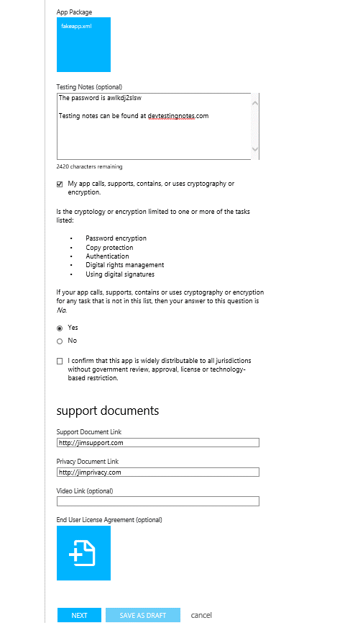
Overview (Part II)
Upload App Package by clicking on blue square. Should be an .xml Manifest (for Office) or an .app package (for SharePoint).
Optional place to list instructions, links and app credentials to help Store team validate your app. Will be used ONLY for internal testing.
Must specify if the app calls, supports, contains or uses cryptography or encryption, and for which tasks. Must either confirm that app uses limited cryptography by selecting “Yes” clicking checkbox, or click “No” and provide ECCN number.
Provide required links to developer’s Support, Privacy Policy and (optionally) demo-video sites. All must include http:// or https://
Optionally upload a custom End-User License Agreement (if not using the Store’s standard one). Roll over blue tile to see approved document formats; click to upload

Slide 30
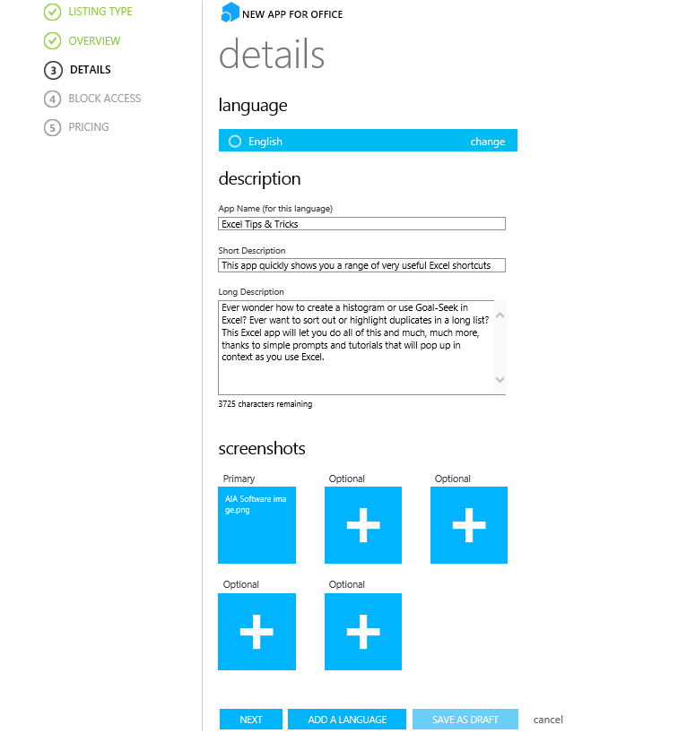
App Details
Choose one of the Store’s supported languages to publish the app in.
App Name is localized to each Storefront in which the app appears, so the name should be localized per supported language.
Short Description can be up to 100 characters, and should be localized per supported language
Long description can be up to 4,000 characters, localized per supported language
Load 1-5 screenshots of your app to display in Store
Make sure the shots exclude any personal or private data.
Must be exactly 512 x 384 pixels, and < 300 KB
Must be a ‘live,’ unaltered shot of the app running in a licensed copy of Office
Scan images for viruses before uploading
Repeat the process for each supported language

Slide 31
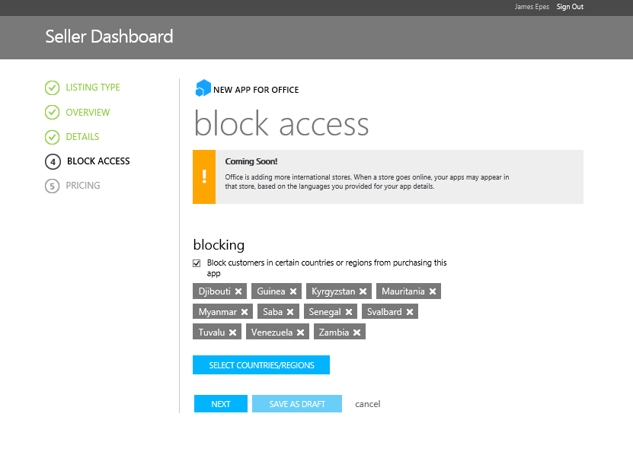
Blocked-country access
Regardless of supported languages, developers can choose to block their apps from appearing in specific markets. China apps MUST block all other countries.
Now the developer can Save the app as a “Draft” and continue editing it later (or “Submit” if their Account is Active.)

Slide 32
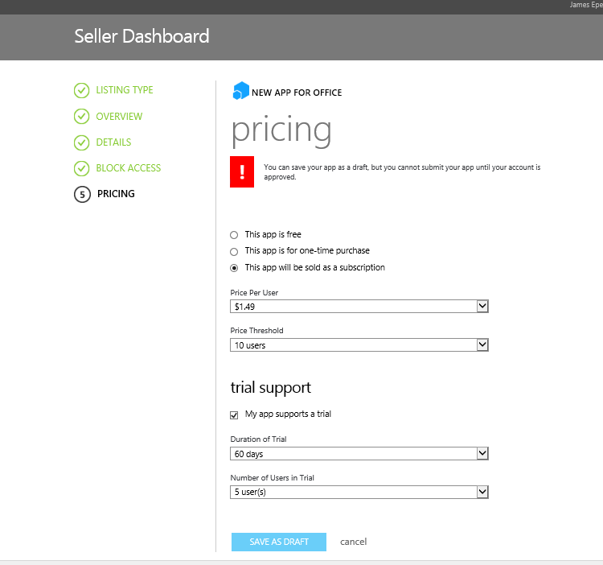
Pricing
Choose your Pricing model.
Note: Even free apps can include advertising or in-app purchases.
Note: you cannot change a paid app from one-time purchase to subscription, or vice-versa, after submittal
Paid apps must charge at least $1.49 per user (to cover admin costs), but can charge more (in 50 cent to $50 increments, up to $999.)
You can cap the app’s max price by setting a user limit (1 to 1,000), beyond which additional users are free.
Regardless of the payment options you select, you can also offer a Trial version that expires after a while.
Set Trial duration (15-60 days), and the max # of users allowed in a Trial (1/5/20/unlimited). The app code itself defines what happens when the Trial runs out – e.g., it stops working, disables certain functionality, etc.
Save your app as a Draft, or (if your account is approved) Submit For Approval to publish in the Store.

Slide 33
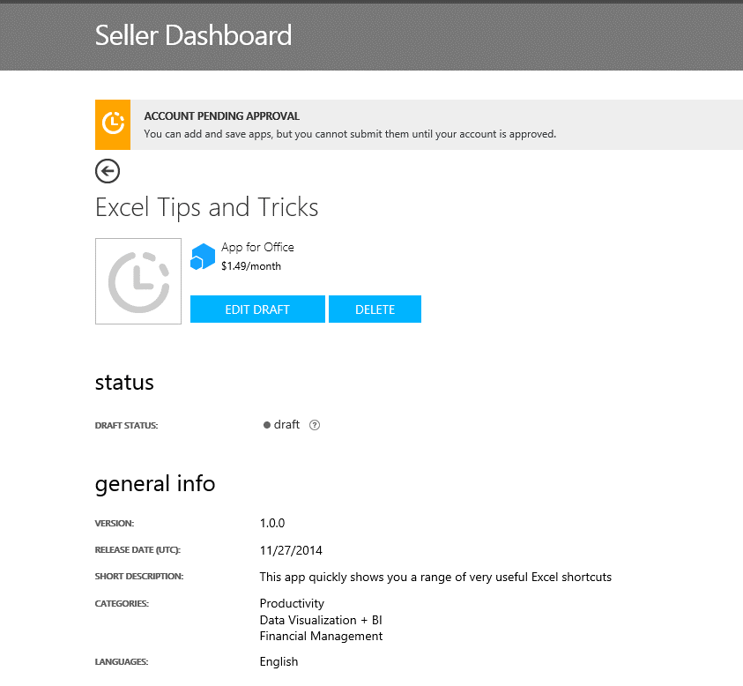
Saved App
You can always come back and edit Drafts. All your saved apps show on the Manage page.
Once you are happy with a Draft (and your Account is approved), you can Submit the App for Store approval.
If there are problems with the submitted app, metadata or media files, the Store team will respond with comments. Once all is approved, the app should publish to the Store within 24 hours to max of 3 days.

Slide 34
Step 3a: Unique Needs of SharePoint Provider-hosted Apps

Slide 35
Creating Client IDs for SharePoint Apps
Client IDs needed for Provider-hosted SharePoint Apps (for Server-to-Server authorization)
IDs grant the remote components of such apps access to SP data w/o disclosing user credentials (OAuth tokens used instead)
Done by registering the app with Azure Access Control Services (ACS). Secrets stored only in ACS, not SharePoint nor SD.
Seller Dashboard MUST be used to create IDs & Secrets for any such SP apps targeted for the Store
NOT Visual Studio: Office Developer Tools wizard creates only a temporary app ID during dev, for registry w/ ACS
NOT SharePoint: The AppRegNew.aspx page in a Site or Farm can only register side-loaded Apps
The Client IDs & Secrets created within SD replace the temporary values in the web.config and Manifest files file of your VS project,
Even SP apps NOT meant for the Store may benefit by registering via Seller Dashboard
Seller Dash will support multi-tenant, multi-site and multi-farm deployment, without requiring each Site Admin to register the app individually
The Seller Dash Secrets policy is more flexible and user friendly: allows for longer Secrets duration and UI-based refresh of expiring Secrets
IDs & Secrets can be created anytime and associated w/ the appropriate SP app later, before Store submission

Slide 36
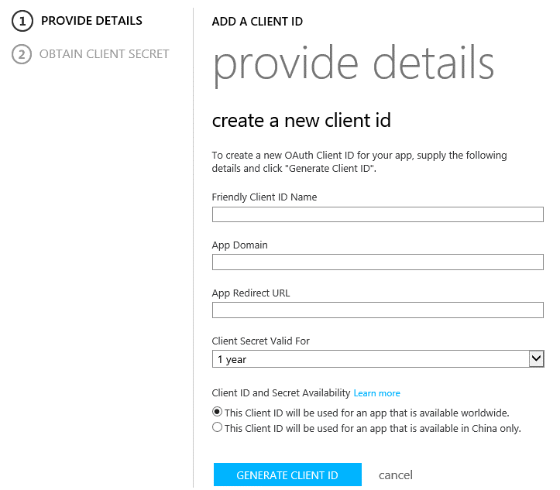
Creating Client IDs (via the “Apps>client ids” tab)
Each app has a unique Client ID; IDs can have multiple associated Secrets, but having more than a few is not recommended
Choose a name to help you recognize which app will use this Client ID, such as “Excel Tips & Tricks”
Provide the domain where your SP app will run. Must be a valid domain name that you own; don’t include http(s):// nor use an international domain name (IDN).
Provide the redirect URL to send users to after they agree to your app's access requirements in the consent dialog box. Must start with https://.
Choose how long your client secret will be valid. Options are 1-3 yrs.; 1 year recommended, but longer has no security impact. Near expiration, you will need to update your Secret to keep the app working.
Note: Client Secrets created directly in SP last only one year, by default.
Apps submitted to China require separate Client IDs and Secrets
Click “Generate Client ID”

Slide 37
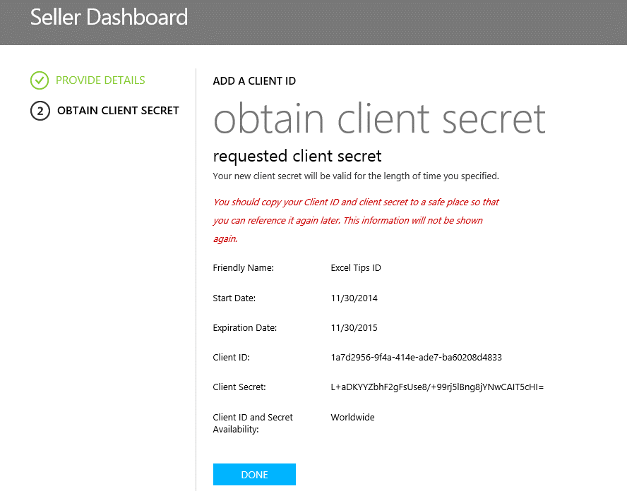
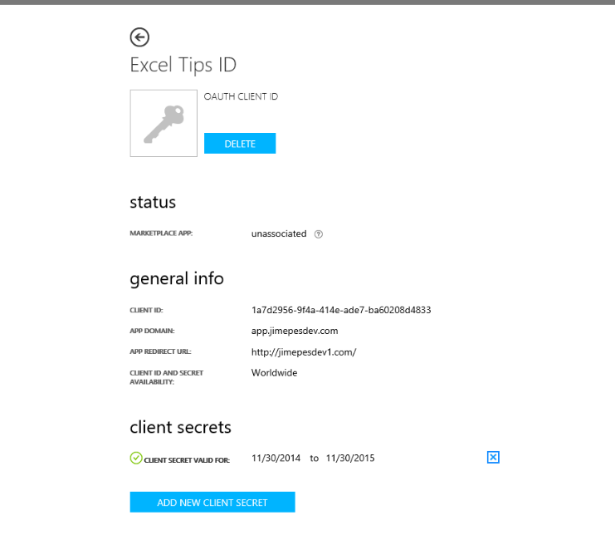
The critical finishing steps
Carefully save the Client Secret in a safe place you control; Click “DONE.” (Below left)
You can track most Client ID details in SD (Below right) -- but NOT the Secrets; they are hidden in Azure ACS!
Add the Client ID and Secret to your app code at any point before fully testing the app
Associate the same ID/Secret to the SP app in Seller Dash by editing or adding the relevant app
Checkmark the “My app is a service and requires server to server authorization” box and then select the Client ID’s Friendly Name.
For soon-to-expire or compromised Secrets: Create a new Secret in SD, Delete the old and associate the replacement with the app

Slide 38
Step 4: Managing Your Apps’ Performance

Slide 39
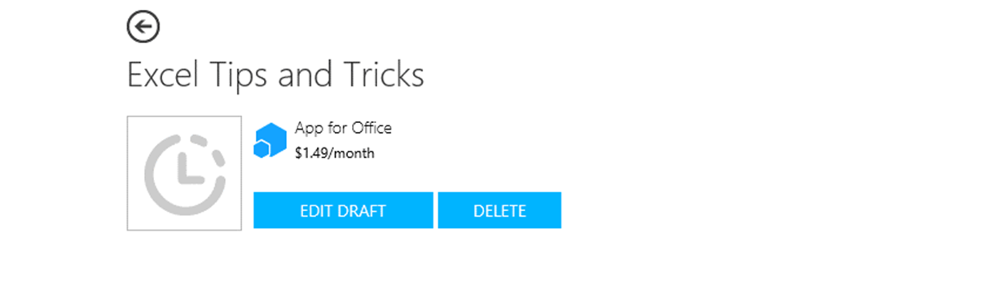
Unpublish and Delete an App in SD
Unpublish Apps from the Store via the “Apps>Manage” tab, when:
You want to replace your app with a new Store version and discontinue the old
You have an issue with the app as it’s behaving in the Store
Completely Delete Apps from SD that are no longer relevant, via “Apps>Manage” tab
To be deleted, Apps must be in Unpublished or in Draft State
Published Apps, or those Pending Approval for the Store, cannot be Deleted
Deleting an App also removes any associated Client ID

Slide 40
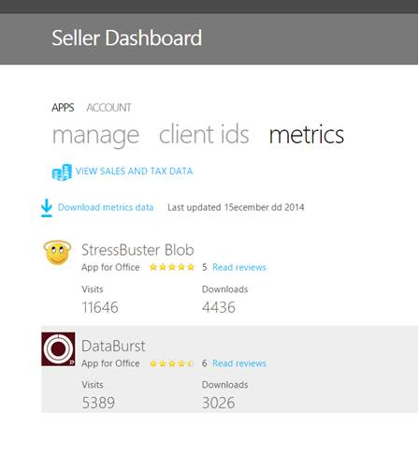
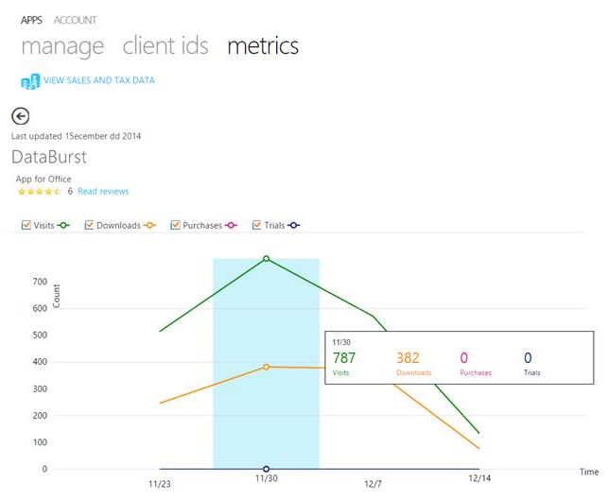
App Metrics & Sales Reports
Metrics for all apps:
Tracks Reviews, weekly Visits, Downloads, Trials and Purchases (Seats and Site Licenses).
CSV downloads add other metrics like Trial Conversions
Currently tracks 4 weeks of data but longer tracking is on the roadmap
Metrics Details for this app
View Sales & Tax Data by clicking HERE
Download more metrics here

Slide 41
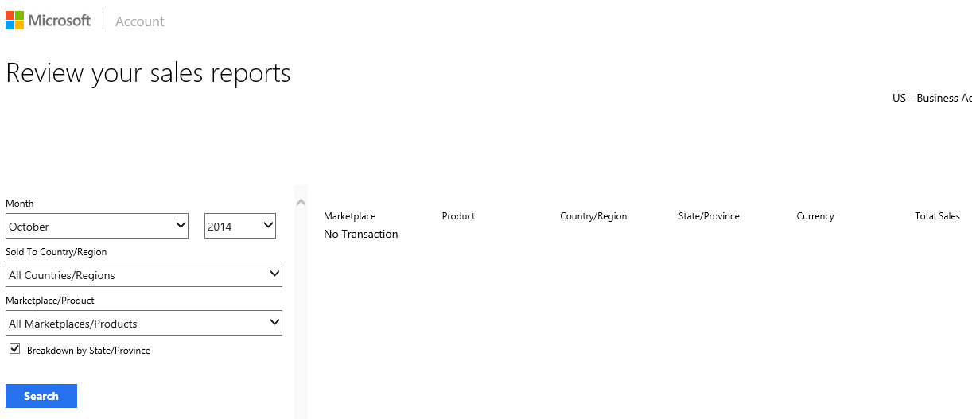
Sales Reports
Consolidated Sales & Tax info across all Microsoft Stores and accounts in a single hub
View data by month, region/country/state, marketplace & currency.
Shows GROSS amounts, before taxes & fees
Office Store pays out when your account accumulates $200, about 45-60 days after that period’s 1st sale

Slide 42
Review of Common Blockers

Slide 43
Common errors: Account Creation
Fake Data – a sure rejection
Business rather than personal info in RESIDENTIAL contact form
Incorrect Tax data formats
Spelling & grammar errors
Vague & incomplete descriptions

Slide 44
Common Errors: App Submission
#1 mistake: The app version number in Manifest differs from the version # in Seller Dashboard
Other top errors
The Privacy link doesn’t go to a valid Privacy Statement
A non-existent or bad Support URL (or no SupportURL element in the Manifest)
The app fails to disclose that it doesn’t work in IE8 or other specified browsers
The app doesn’t function as described or displays error dialogs
App package lacks the SupportedLocales element (required even if just one country supported)
TIP for handling thorny issues
Use the Testing Notes feature to offer testing instructions or to ask about validation failures you don’t understand.

Slide 45
No Bad Store Apps (highlights of App Validation Policies)
Avoid the obvious (viruses, offensive content, false claims, app instability)
Trial app functions must “reasonably resemble” the paid version
If your app processes credit cards, it must be PCI compliant
Don’t use updates to unexpectedly degrade features
Honor past agreements when updating pricing, support, licensing terms
Make sure your app supports touch and all supported OS, browsers, etc.
Respect all copyrights & trademarks in your logos, content, code, etc.
SharePoint apps cannot request “Full Control” permissions or be auto-hosted.

Slide 46
Making your App listing shine
Professional appearance matters!
Crisp clear logo, appealing UI, harmonious colors, clear/concise message, localized metadata
Visuals are especially critical
Quality screen shots, links to videos, compliant ads (if any)
Create Trust
Free/Trial versions, Reviews, Contact Info, Privacy Statement, Support statement
Stick to intuitive UI and interaction model
Also don’t forget to design for touch
You’re not done when the App is in the Store
Outbound marketing, upsell from Trials

Slide 47
demo
Seller Dashboard

Slide 48
Summary
Overview
Build Your App
Create an Account in Seller Dashboard
Add an App
SP Provider Hosted Apps
Managing App Performance
Review of Common Blockers

Slide 49



dev.office.com
Sign up
http://dev.office.com/getting-started
Explore
http://apisandbox.msdn.microsoft.com
Get trained http://dev.office.com/training

Slide 50


Feedback
Office 365 Network Share your best practices and join conversations https://www.yammer.com/itpronetwork
Stackoverflow Ask deep technical questions to a world-wide set of developers
http://stackoverflow.com/questions/tagged/ms-office
UserVoice Provide suggestions of what you want in future versions
http://officespdev.uservoice.com/

